Slide 1
1.2 | Peak Cooling Load
1
Concept and Design Basis
peak
Air Conditioning · Chapter 1 · Topic 1.2

Slide 2
A room warms up when heat enters faster than the system removes it
2
Use a simple balance: heat gain versus cooling capacity.
Heat gain raises the room load.
Cooling capacity must remove heat at the required rate.
Air Conditioning · Chapter 1 · Topic 1.2

Slide 3
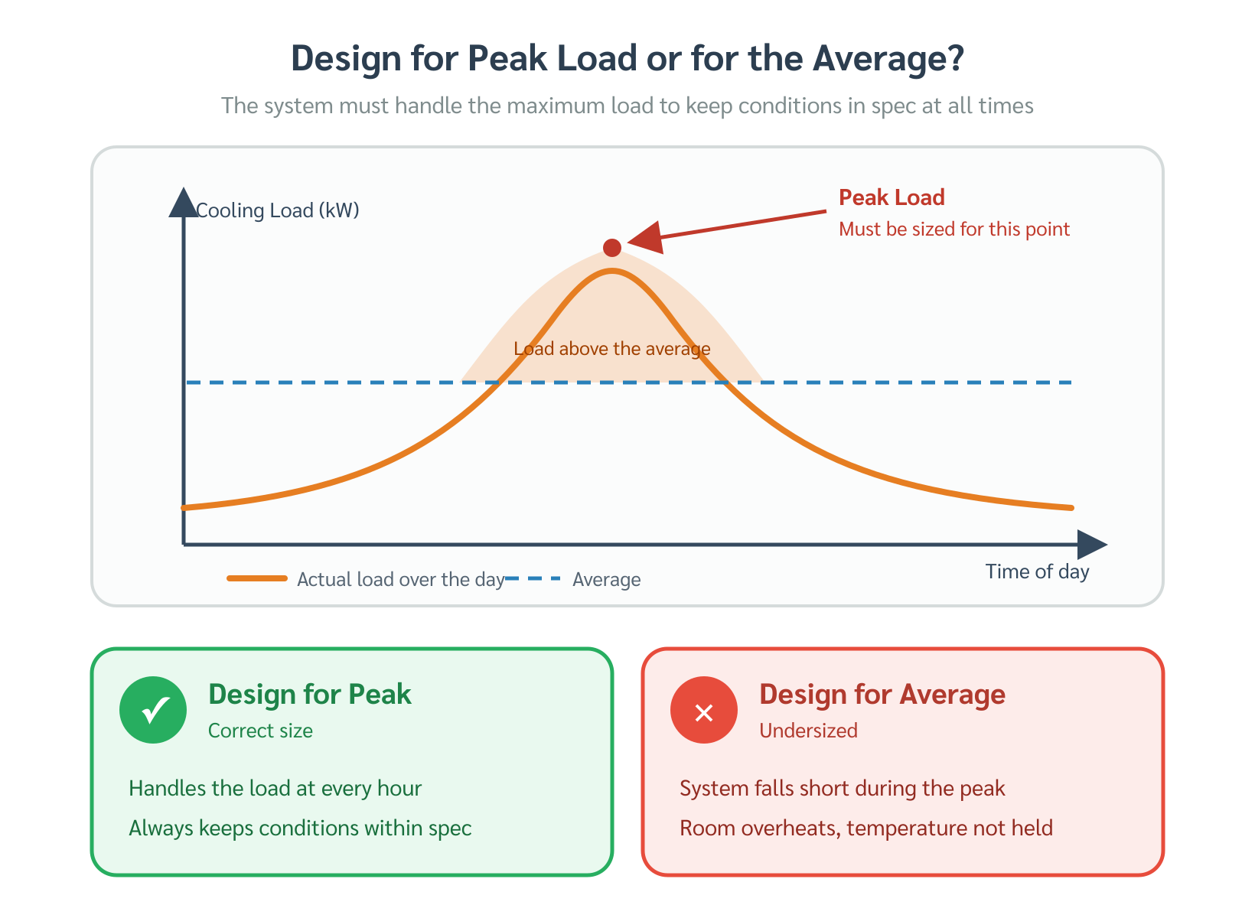
Peak cooling load is the maximum simultaneous heat gain
3
A daily profile converts a moving problem into one design hour.
The design point is the maximum expected load during operation.
Do not size equipment using only an average load.
Air Conditioning · Chapter 1 · Topic 1.2

Slide 4
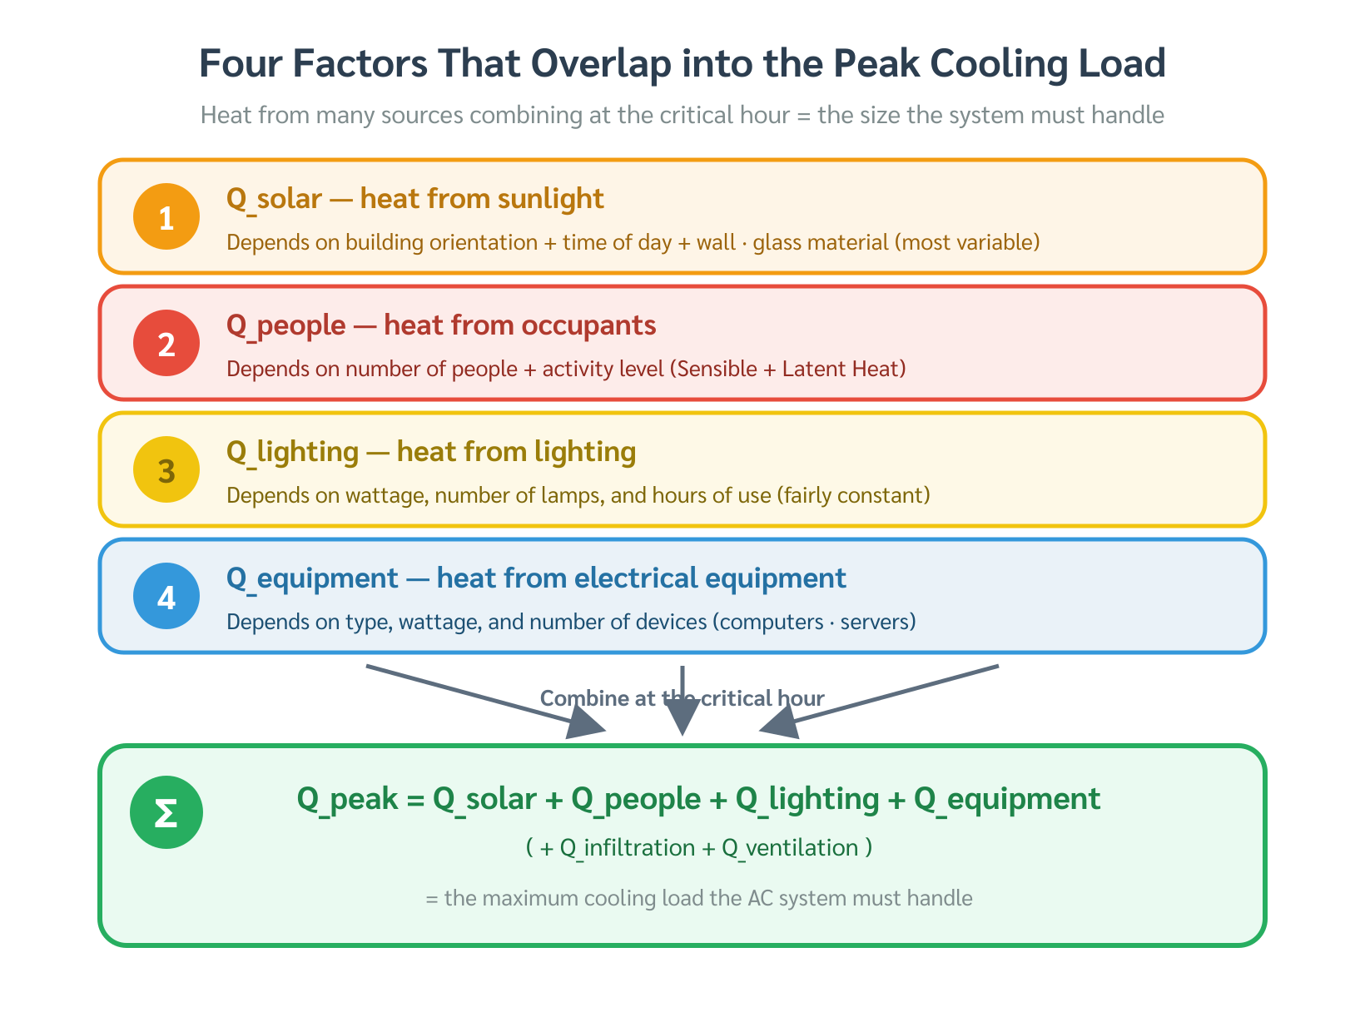
Total load is built from three families of heat gain
4
Use categories before equations.
External load: solar + envelope conduction + lag
Internal load: people + lighting + equipment
Outdoor air load: ventilation + infiltration
Air Conditioning · Chapter 1 · Topic 1.2

Slide 5
Envelope heat gain can arrive hours after the sun hits the building
5
Thermal lag shifts the load peak into the afternoon.
Wall and roof mass store heat temporarily.
The indoor cooling load may peak after solar noon.
Air Conditioning · Chapter 1 · Topic 1.2

Slide 6
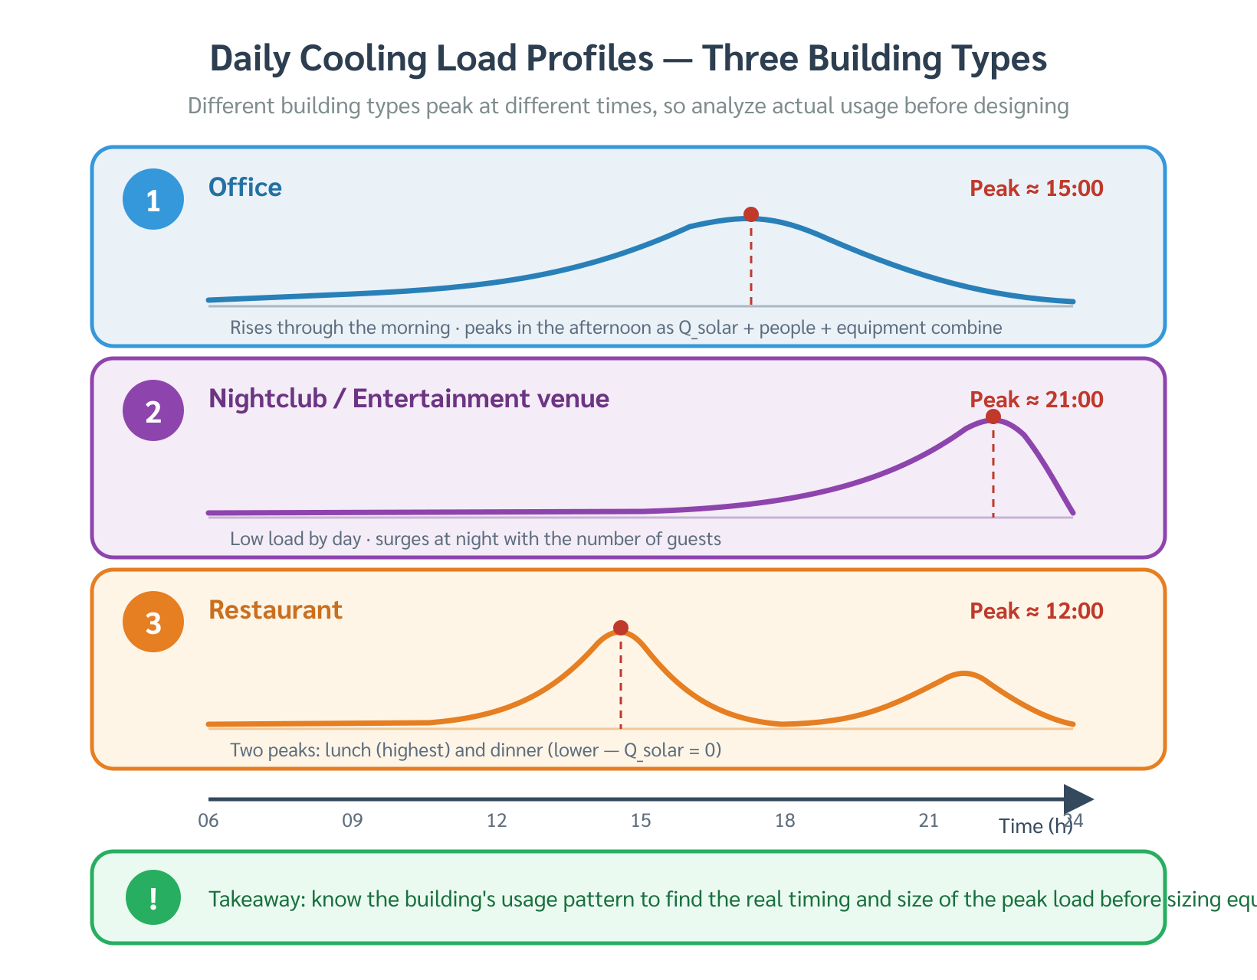
Office buildings often peak at 15:00–16:00
6
West solar gain, thermal lag, and internal gains overlap.
Solar load + internal load + time lag create the peak period.
The peak hour depends on building use and orientation.
Air Conditioning · Chapter 1 · Topic 1.2

Slide 7
A nightclub peaks at night because the use pattern changes the load
7
Peak time follows dominant heat sources.
Solar gain may be zero at night.
Occupants, lighting, latent heat, and equipment dominate.
Air Conditioning · Chapter 1 · Topic 1.2

Slide 8
Wrong capacity creates two different failure modes
8
Both undersizing and oversizing are engineering mistakes.
Undersized: cannot hold setpoint at peak.
Oversized: short cycling, poor humidity control, and higher cost.
Air Conditioning · Chapter 1 · Topic 1.2

Slide 9
Peak load calculation is a structured workflow
9
Before equipment selection, calculate the hourly total.
Survey → design conditions → load components → hourly total → equipment selection
Air Conditioning · Chapter 1 · Topic 1.2

Slide 10
Quick check before moving on
10
Why is peak load not always at noon?
Which load component is most dependent on building use?
Why can oversizing be a problem?
Air Conditioning · Chapter 1 · Topic 1.2

